Slide 1


RECIDIVISM RADAR
PRESENTED BY :
Saleh El Moukahal

Slide 2

OVERVIEW
1- Introduction
2- Data Warehouse Design
3- ETL Process
4- Machine Learning Model
5- Time Series Analysis
6- Power BI Dashboard

Slide 3
INTRODUCTION
Hello all, I’m Saleh El Moukahal a computer engineer and today I’m gonna discuss the Recidivism through my Data project “Recidivism Radar”.
What is Recidivism ?
In our context it is committing new offenses after being punished for a crime.
What to expect in this project ?
Analysis for the reasons and pattern behind recidivists behavior and the general socioeconomics conditions that lead them to relapse into crimes again.
You will be able, through a machine learning model to predict recidivism based on some important inputs.,

Slide 4
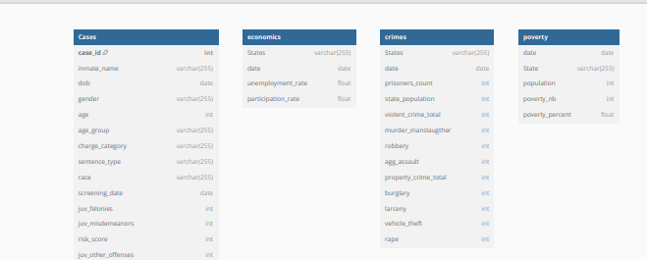

DATA WAREHOUSE DESIGN
At the beginning we had 2 datasets, one for the cases of inmates and the other for the general situation of crimes counts, socioeconomics and poverty.

Slide 5
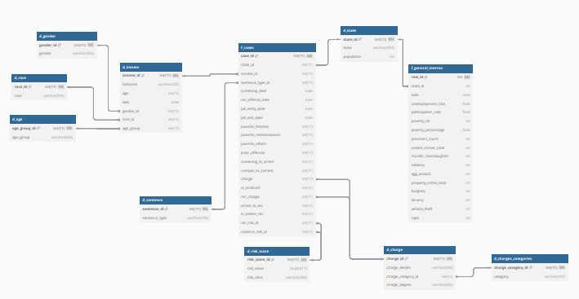
DATA WAREHOUSE DESIGN
Then after reviewing the data well, I normalized what need to from the cases table then from all the datasets and merged the socioeconomics with the poverty and crimes tables.
The final design is mostly a snowflake with 2 fact tables and 9 dimension tables.

Slide 6

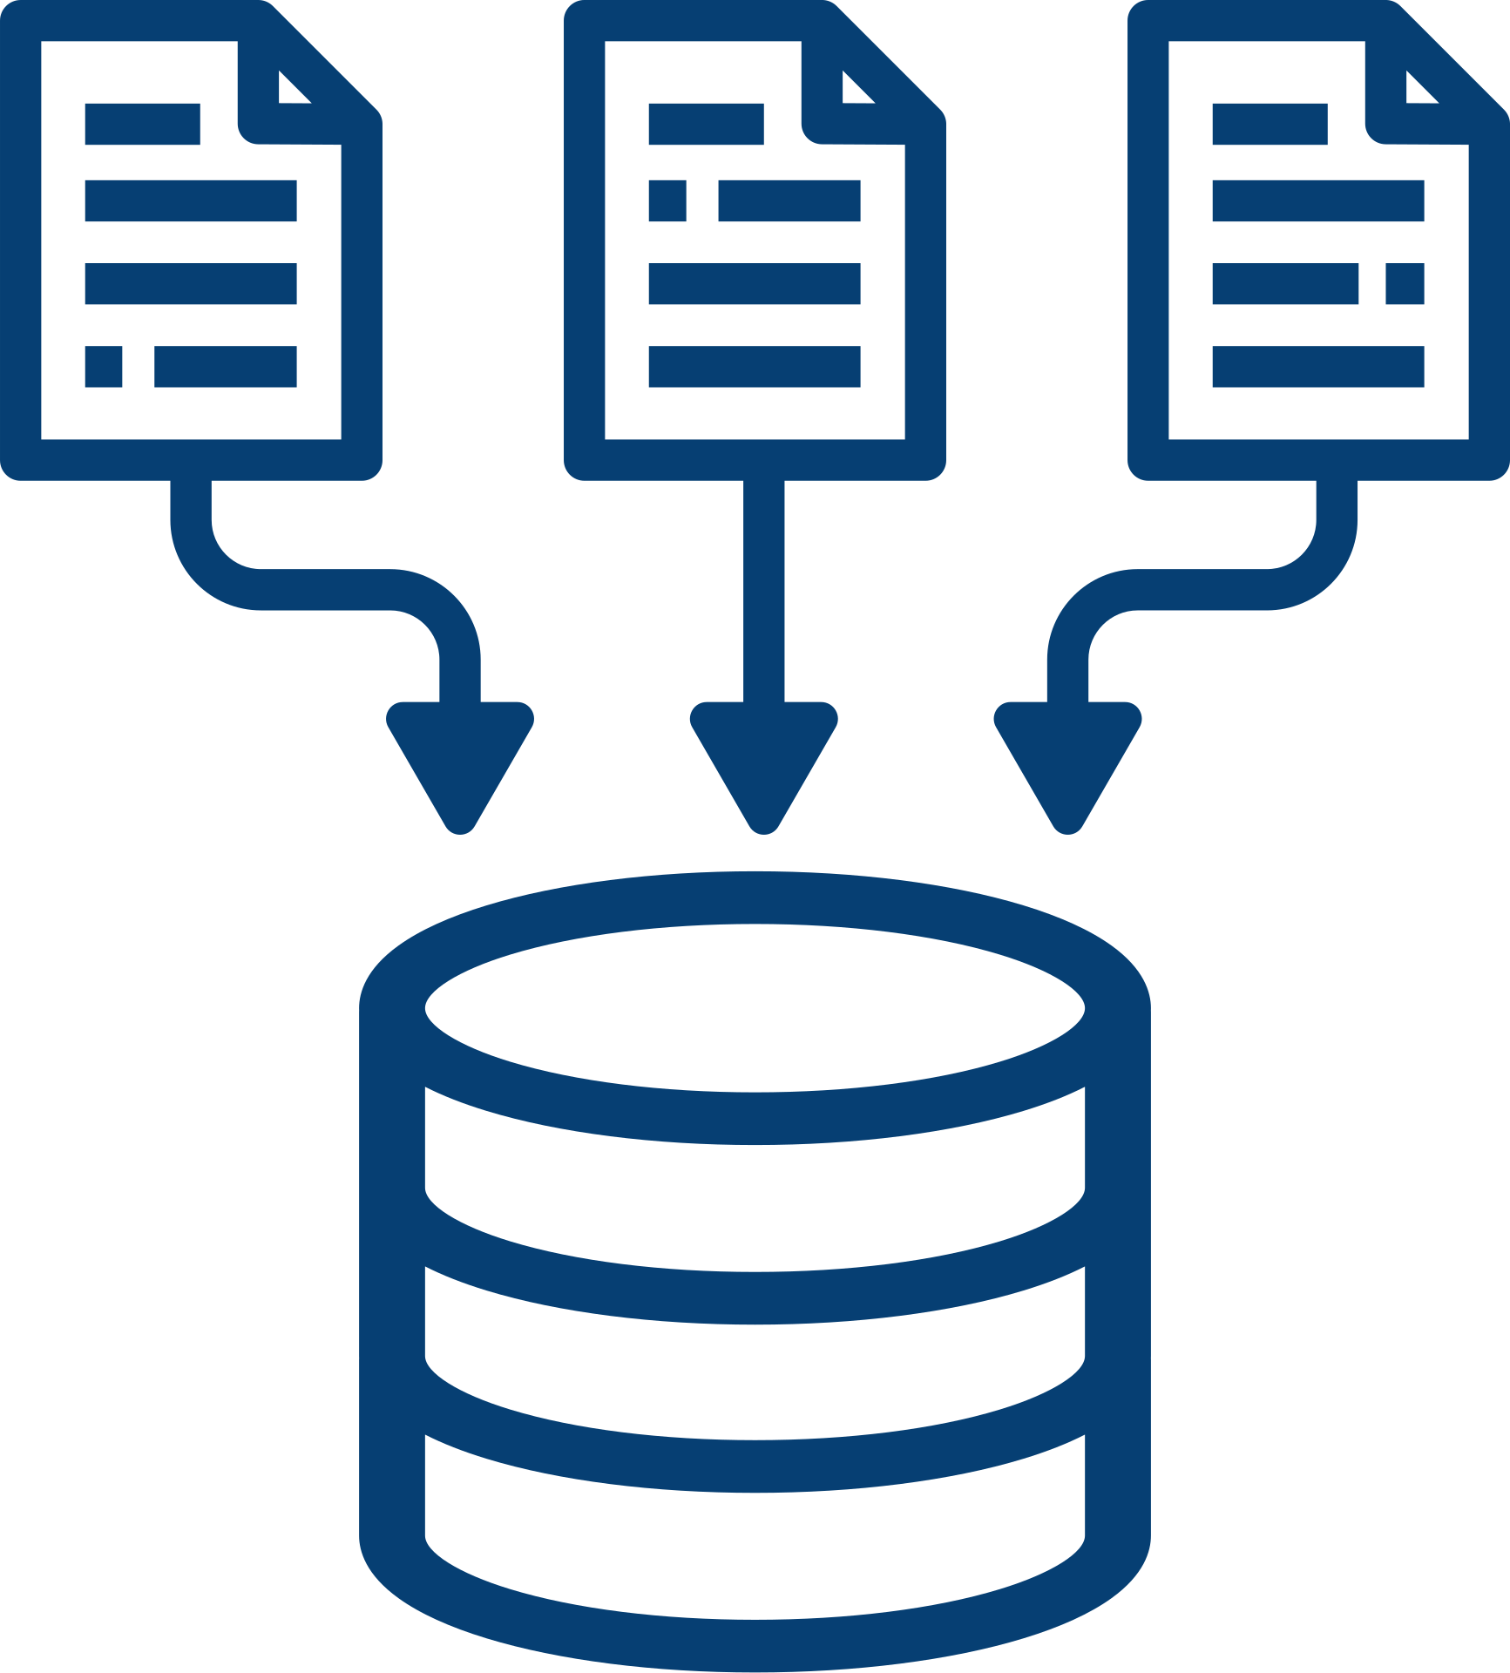
ETL PROCESS
Extraction : In this phase we extract data from csv files to read them on Jupyter Notebook to prepare them for the Transformation.

Slide 7
ETL PROCESS
Transformation: In this phase I fixed the data types as I wish, then filled the null values, dropped replicated columns and created new ones for better analysis.

Slide 8
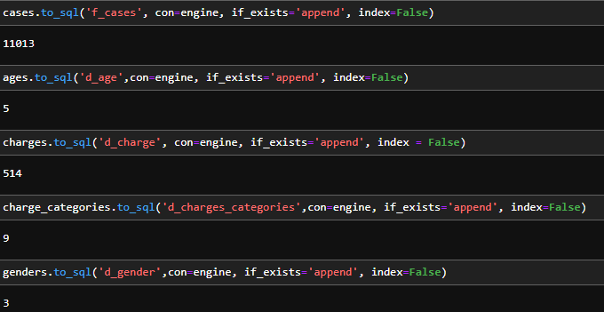
ETL PROCESS
Loading : At this point I loaded the dimension tables then the 2 fact tables I had.

Slide 9

MACHINE LEARNING MODEL
Using random forest, I created a model to predict recidivism based on multiple inputs:
Age
Sex
Race
Charge degree
Juvenile total Offenses
Prior Offenses
Detention Period
The output of this model will give a binary value (1 or 0) to predict if an inmate is gonna be a recidivist or not

Slide 10
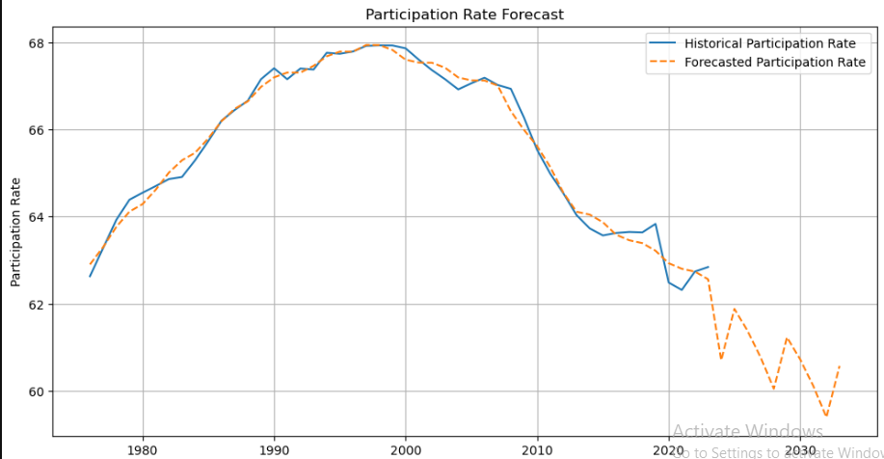

TIME SERIES ANALYSIS
Using python libraries like seaborn, prophet, matpoltlib, I started the time series analysis to uncover insights about the socioeconomic situation of the states over time and a lot more ideas related to crimes and poverty.

Slide 11

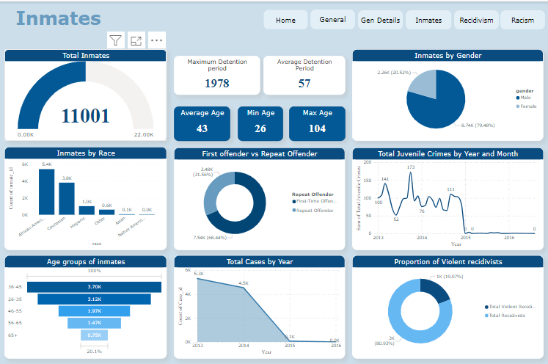
POWER BI DASHBOARD
With power bi strong visualization capabilities, I created numerous visuals to discover and analyze what affects crimes numbers and recidivism rates.

Slide 12

THE END !
Thank you for your attention and listening, I hope this have been informative for you.

